Slide 1

Know-Brainer
Adam, Marias, Darian, Chirag
HackCambridge 2018

Slide 2
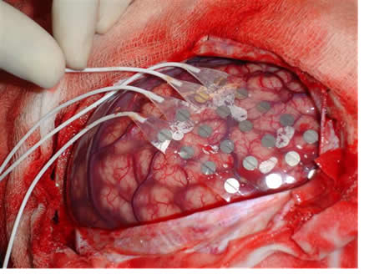
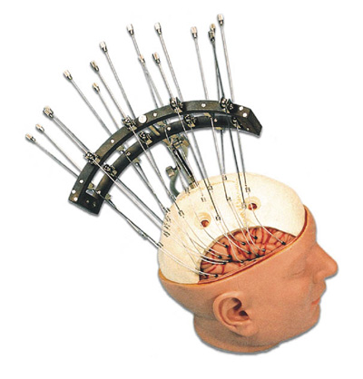
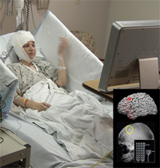
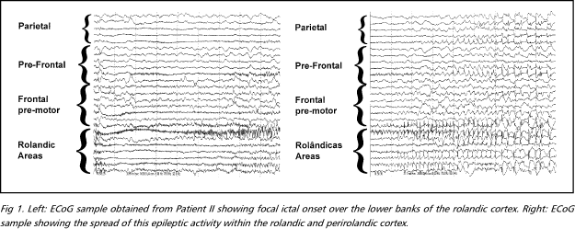
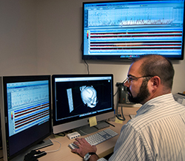
Electrode Implantation
Monitoring (Days/Weeks)
Clinical Team Attempts to Localize Visually
High Healthcare Costs
Hours of time

Slide 3
Goal and Value Proposition
Personalized
Interactive application
State-of-the-art algorithms
Supervised

Slide 5
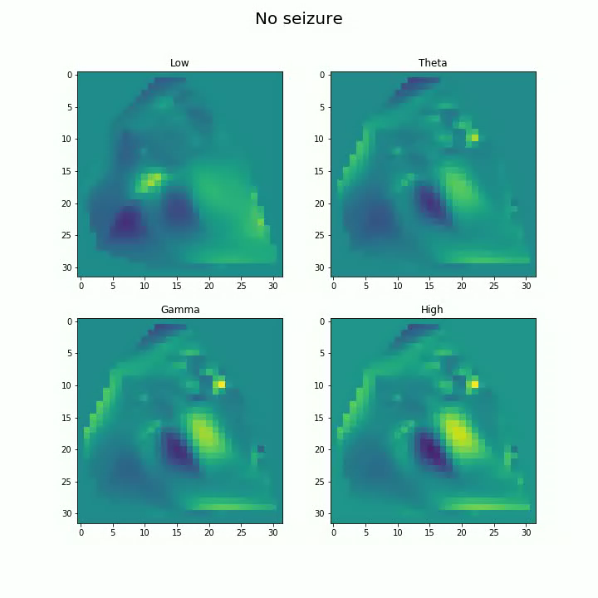

Slide 6
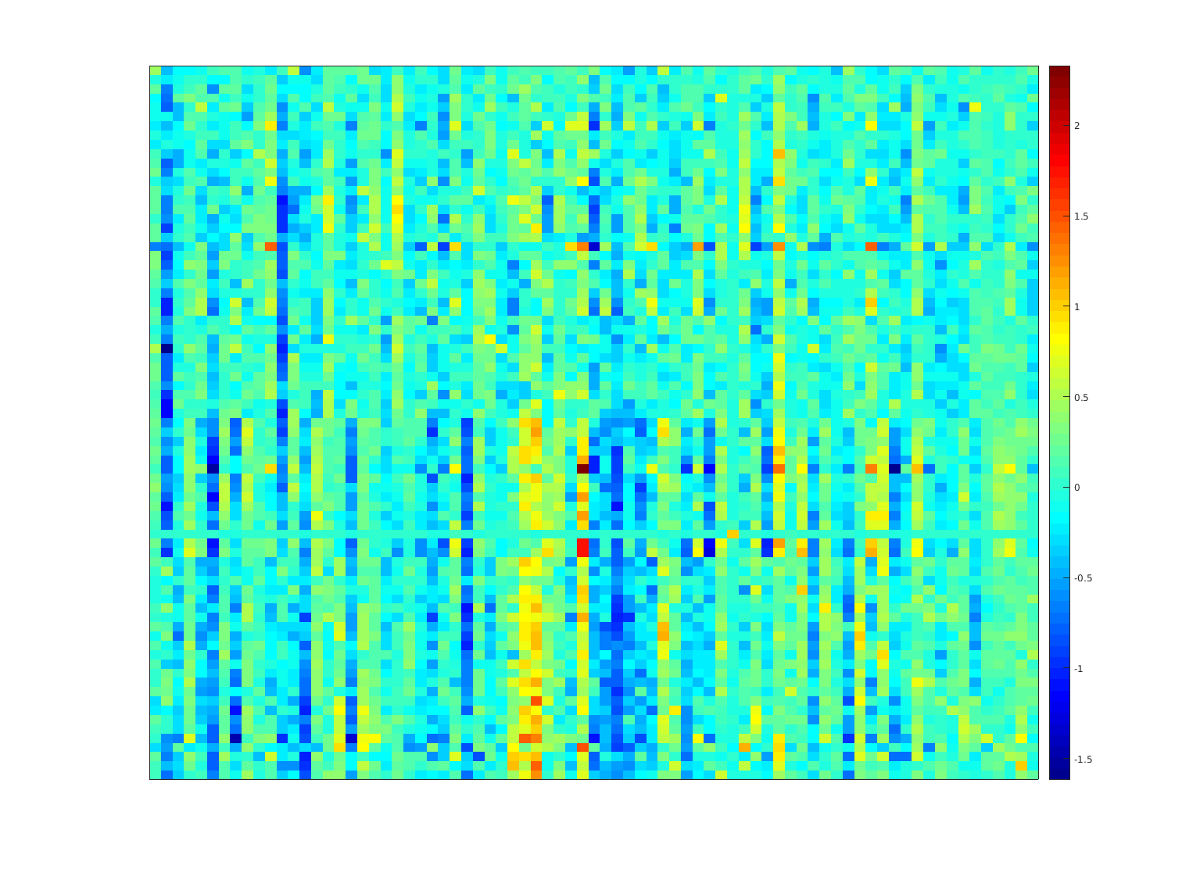
. . .
. . .
MultiTaper FFT
Custom Vision Recognition

Slide 7
Appendix

Slide 8
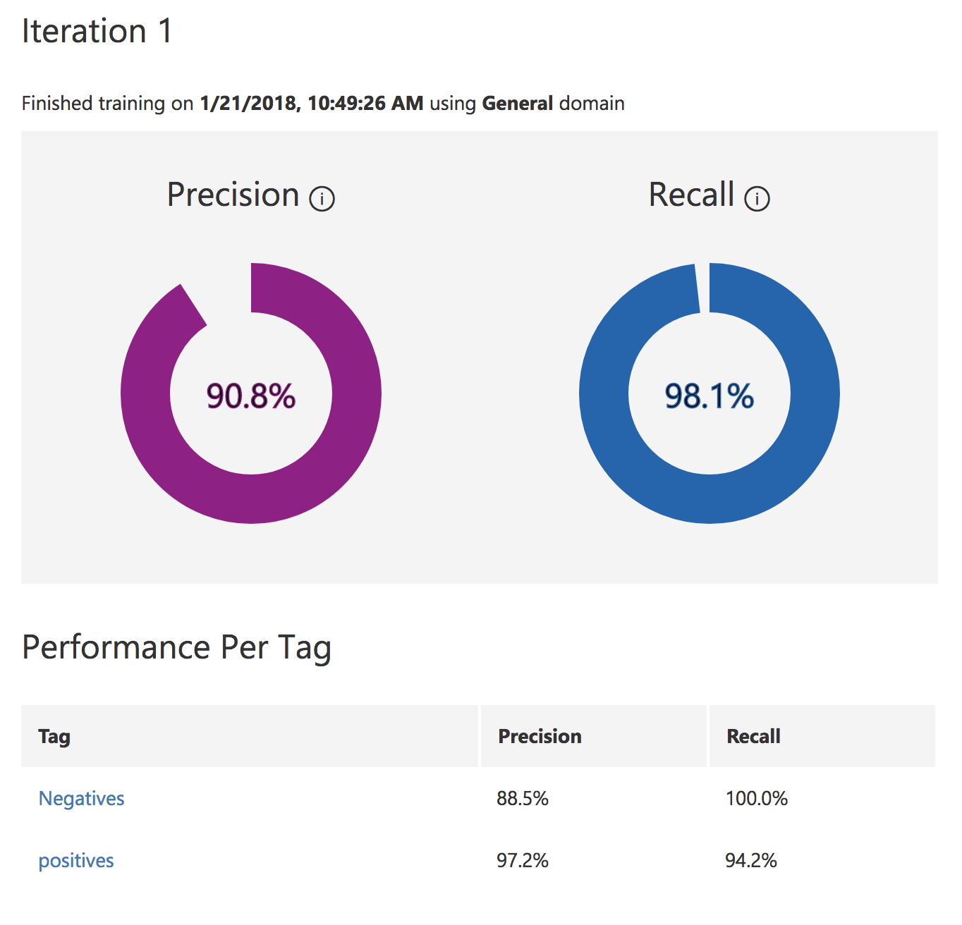

Slide 9
